Slide 1
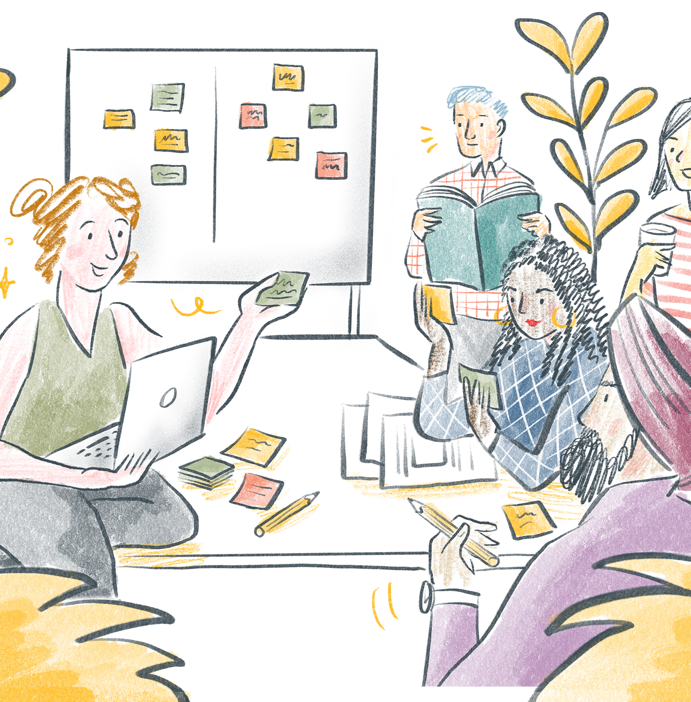
Knox City Council Asset Plan
Community Panel

Slide 2




Recruitment process overview
Public EOI
Representative of the Knox community
Random selection
Recruitment
From the received expressions of interest Capire to undertake a de-identified random selection process to match respondents to the target criteria.
We received over 80 expressions of interest and selected 25 members.
Broad and accessible invitation to participate.
Promotion via corporate and targeted communication channels and an invitation to previous Council Plan panel members.
Aim was to recruit a demographic mix, geographical spread and representation from underrepresented groups that broadly represents the diversity of the Knox community.
Selection process steps
First priority: Representation across suburb, age and gender.
Second priority: A spread across family composition, representation from business owners alongside access and equity targets.
Third priority: Participants with varying lengths of connection to the area and previous council involvement.

Slide 3
Summary of selected participants
Category | Criteria | Target | Panel
Gender
 | Man | 12 | 12
 | Woman | 12 | 12
 | Non-binary | 1 | 1
Age group
 | 18 – 29 years | 4 | 4
 | 30 – 39 years | 4 | 5
 | 40 – 49 years | 4 | 5
 | 50 – 59 years | 4 | 3
 | 60 – 69 years | 4 | 5
 | 70 – 84 years | 3 | 3
 | 85 years + | 1 | No EOIs received
Suburb
 | Bayswater | 2 | 2
 | Boronia | 4 | 3
 | Ferntree Gulley | 4 | 4
 | Knoxfield | 1 | 2
 | Lysterfield | 1 | 1
 | Rowville | 5 | 5
 | Scoresby | 1 | 1
 | The Basin | 1 | 1
 | Upper Ferntree Gully | 0.4 | 1
 | Wantirna | 2 | 2
 | Wantirna South | 3 | 3
Key:
If the criteria is coloured green the target has been met

Slide 4
Panel Composition
Category | Criteria | Target | Panel
Language spoken at home
 | English | 17
 | Languages other than English | 8 | 12
Council involvement
 | I have participated in a Council consultation previously | 12 | 11
 | I have not participated in a Council consultation previously | 12 | 13
 | Not sure |  | 1
Family composition
 | Couple with children | 10 | 10
 | Couple without children | 6 | 7
 | One parent family | 3 | 1
 | Lone person household | 5 | 3
 | Group household | 1 | 4
Business Ownership
 | I own a business in Knox | 5 | 2
 | I do not own a business in Knox | 20 | 23
Length of Connection to Knox
 | I have been connected to Knox for less than 2 years | 5 | 3
 | I have been connected to Knox for 3 - 9 years | 10 | 9
 | I have been connected to Knox for 10 or more years | 10 | 13
Key:
If the criteria is coloured green the target has been met

